Slide 1
Postman
Keycloak
Spring Boot 3 App
Client
Authentication Server
Resource Server
Request token
token
Request resource with token
Authenticate
Authenticated
Authentication
Resource Response

Slide 2
Postman
Request resource with token
Resource Response
Spring Boot 3 App
token
Request token
Authenticated
Keycloak
Authenticate
Authentication

Slide 3
Postman
Request resource with token
Resource Response
Spring Boot 3 App
Security
Filter
token
Request token
Authenticated
Keycloak
Authenticate
Authentication

Slide 4
Postman
Request resource with token
Spring Boot 3 App
Resource Response
Security Filter
Oauth2
Resource
token
Request token
Authenticated
Keycloak
Authenticate
Authentication

Slide 5
Postman
Request resource with token
Security Filter
Resource Response
JWT
Oauth2
Resource
token
Request token
Can use either JWT or OpaqueToken but not both
Authenticated
OpaqueToken
Keycloak
Authenticate
Authentication

Slide 6
Postman
Request resource with token
Security Filter
Resource Response
Oauth2
Resource
token
Request token
Token is validated within Resource server
JWT
Authenticated
Keycloak
Authenticate
Authentication

Slide 7
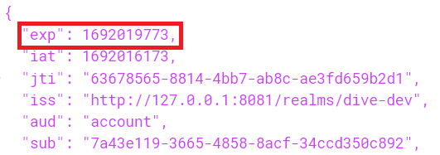
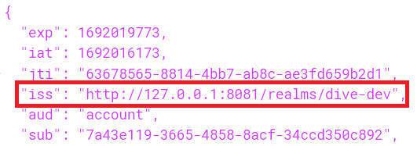
Postman
Request resource with token
Resource Response
JwtTimestampValidator
token
Request token
JWT
JwtIssuerValidator
JwtClaimValidator
Keycloak
Authentication
Using JWT for authentication

Slide 8
JwtTimestampValidator
Get current time in seconds and deduct 60 seconds from it.
Get the time in seconds from the access_token’s “exp” property.
Check if “current_time - 60” < “exp”.
If yes then its a valid token.
Else the token is expired.
Using JWT for authentication

Slide 9
JwtIssuerValidator - JwtClaimValidator
Get the value from property spring.security.oauth2.resourceserver.jwt.issuer-uri.
Get the value from the access_token’s “iss” property.
Check if both the strings are equal.
If yes then its a valid token.
Else the token has invalid issuer.
Using JWT for authentication

Slide 10
Postman
Request resource with token
Security Filter
Resource Response
Oauth2
Resource
token
Request token
Token is validated in Keycloak
OpaqueToken
Authenticated
Keycloak
Authenticate
Authentication
Using OpaqueToken for authentication

Slide 11
REST call to keycloak
Postman
Request resource with token
Resource Response
SpringOpaqueTokenIntrospector
token
Request token
OpaqueToken
Authenticated
Keycloak
Authenticate
Authentication
Using OpaqueToken for authentication

Slide 12
SpringOpaqueTokenIntrospector
Get the value from property spring.security.oauth2.resourceserver.opaquetoken.introspection-uri as introspectURI.
Get the value from property spring.security.oauth2.resourceserver.opaquetoken.client-id as clientId.
Get the value from property spring.security.oauth2.resourceserver.opaquetoken.client-secret as clientSecret.
Using RestTemplate object, make an API call using introspectURI, clientId, and clientSecret.
Using OpaqueToken for authentication

